Slide 1

Data breaches
Building secure web apps within minutes
Azure User Group – San Diego
August 2015
Sid Shetye
sid@crypteron.com

Slide 2




About the speaker
Sid Shetye - Founder & CEO of Crypteron Inc.
Sid is a leading security expert with over a decade of experience in the security and cloud software space. A developer a heart, he has engineered the largest deployment of secure boot devices on the planet whose deployments include commercial phone manufacturers as well as government agencies. Sid designed the growth strategy for ecoATM’s founders which then sold for $350M a year later. He has a Masters in Electrical Engineering (Security) from The University of Southern California and an MBA from UCSD’s Rady School of Management.
6+ Billion devices

Slide 3







Heard of data breaches lately?
HACKED !
Total Records Breaches Since 2013:

Slide 4
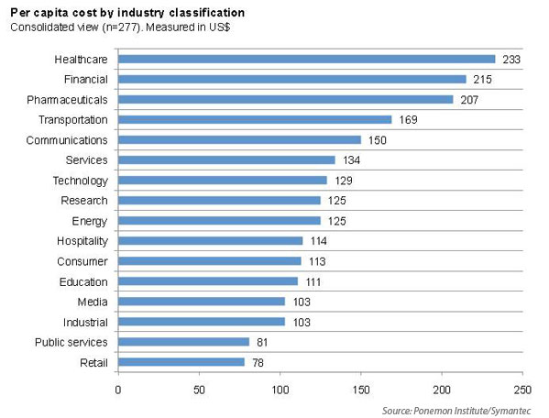
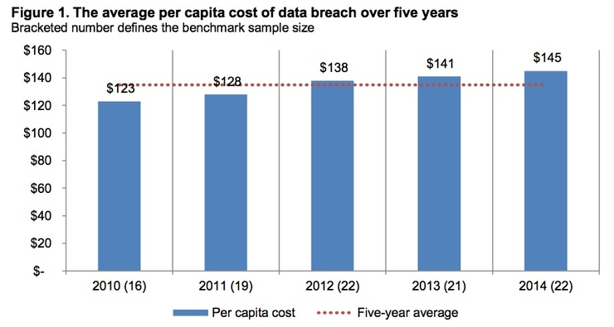
Data Breaches are EXPEN$IVE
Source: Ponemon Institute

Slide 5
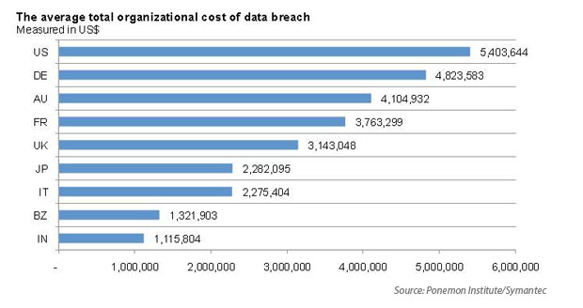
Data Breaches are EXPEN$IVE
Source: Ponemon Institute

Slide 6

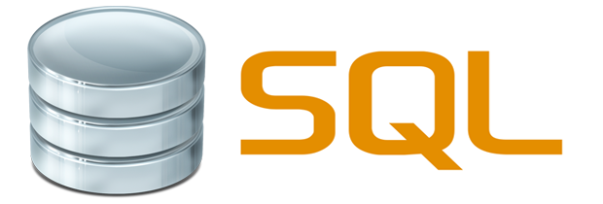




Cloud security competitors
SECURE BUT DIFFICULT
EASY BUT INSECURE
Transparent Data Encryption (TDE)
SQL Server
MySQL
AzureSQL
Amazon RDS
etc.

Slide 7


Robust Security is HARD !

Slide 8
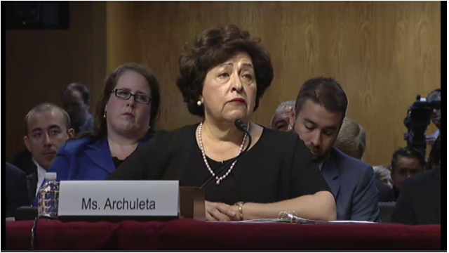

Example: OPM
20 MILLION PEOPLE AFFECTED !
Not easy!

Slide 9

Imagine if cars were built like this …

Slide 10

Fortunately, user experience tames the complexity

Slide 11


So, what is Crypteron?
The Crypteron Security Framework is a platform-as-a-service and SDKs for a cloud-first security solution
Protects businesses from data breaches
Save 12+ months of development time
No Custom Code
Zero Trust Model
Like …
… but for developers tackling security
That’s the best, dev friendly credit card processing partner!

Slide 12


As simple as …
[Secure]
@Secure

Slide 13
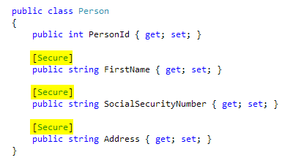
Crypteron Security Framework

Slide 14
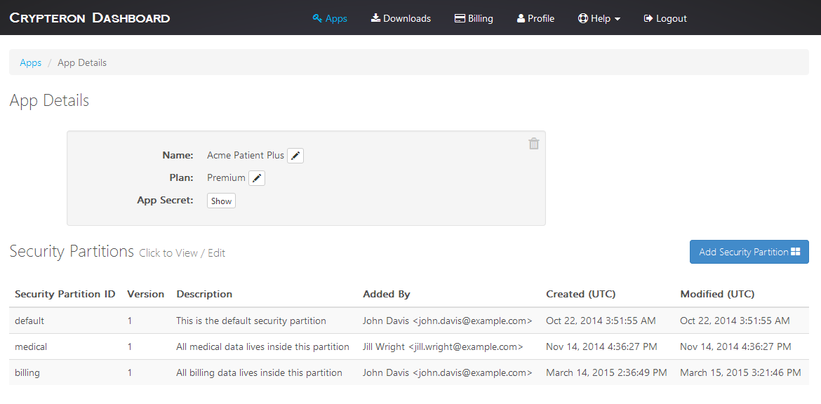
Management Dashboard

Slide 15
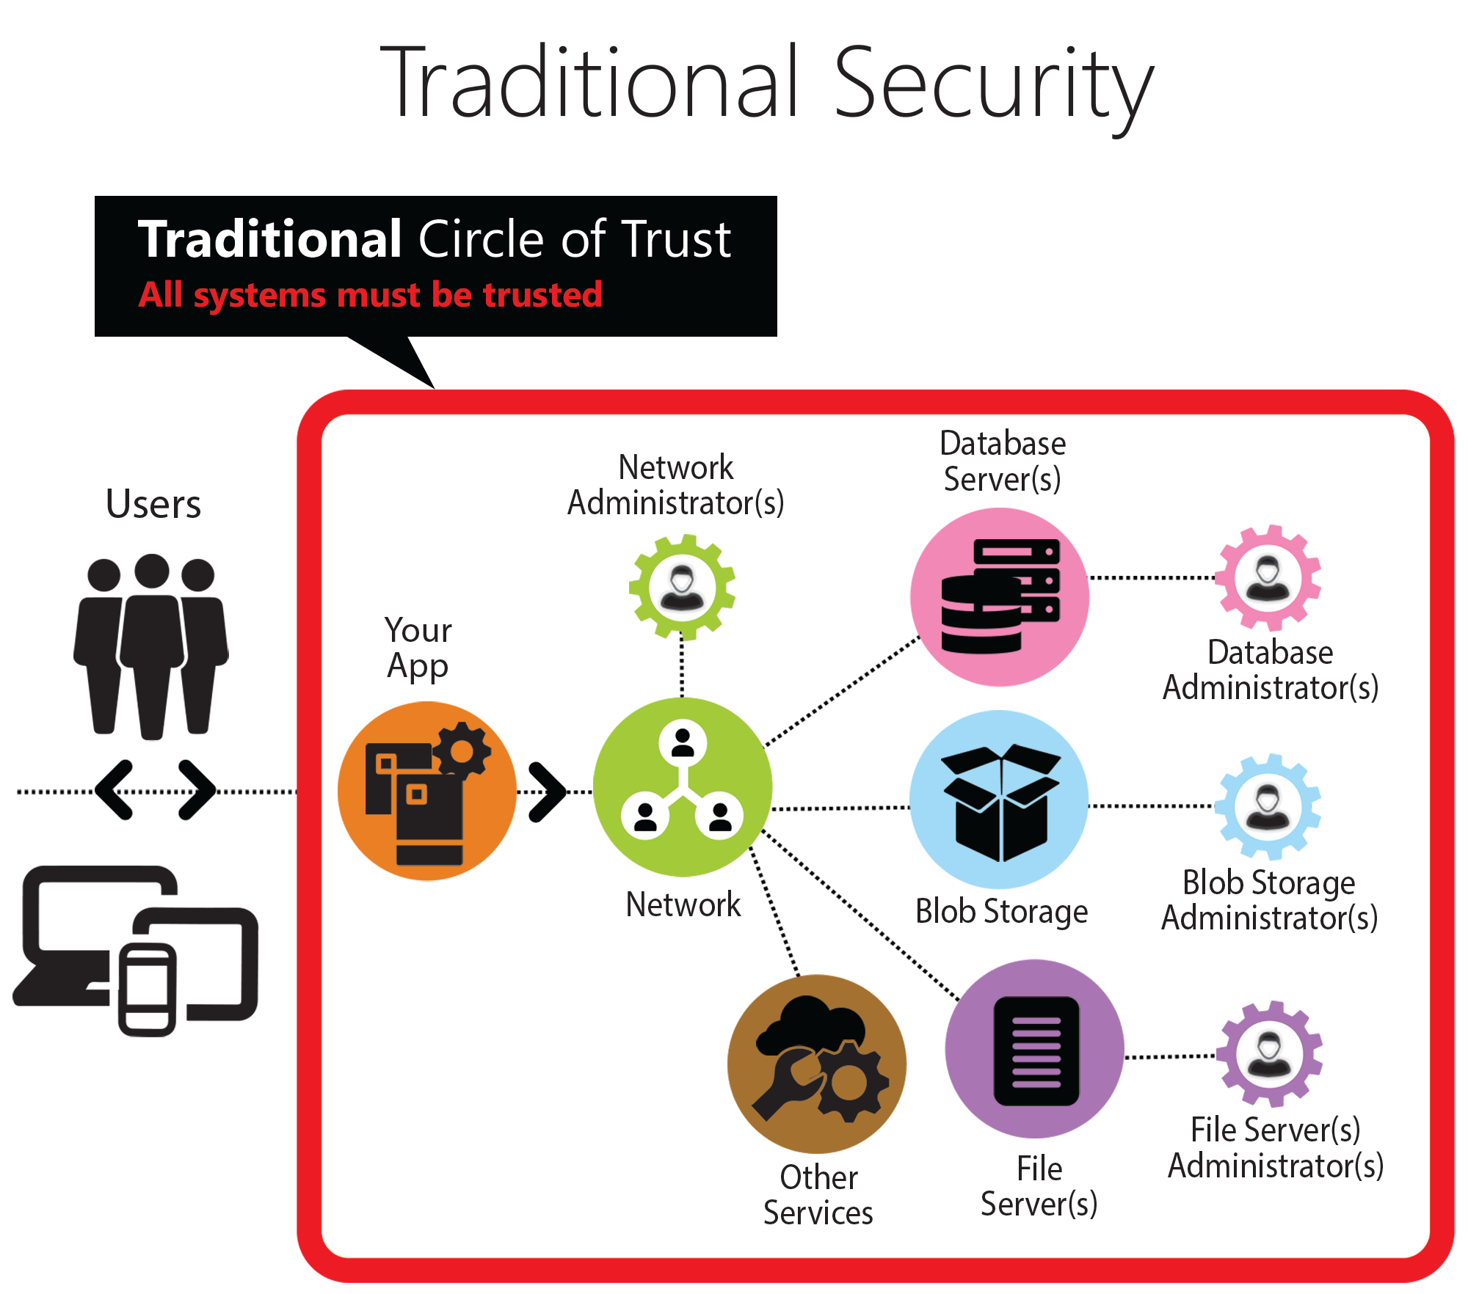

Slide 16
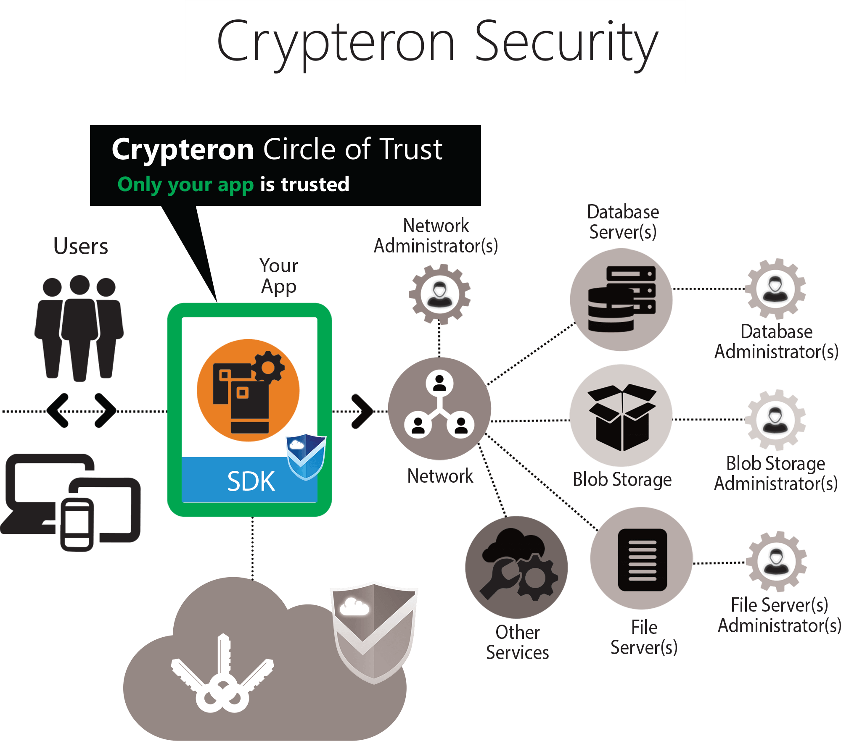

Slide 17




Compliance in the Cloud

Slide 18





This time, it’s different …
Software is everywhere …
Leaders getting fired …
Katherine Archuleta
Gregg Steinhafel

Slide 19

Why should devs care?
Save time, make more money
Promotes DevOps
Differentiated, Secure App development

Slide 20
Developer resources
How to get you started quickly …

Slide 21
Developer Resources
High level concept for business folks (aka “For your boss”)
  Crypteron Explainer Video at crypteron.com
For you, your developers & software architects
  Developer experience video (2mins)
    https://youtu.be/FMwbcnC6oJE
  Developer quick start guides, sample apps and videos
    crypteron.com/docs

Slide 22
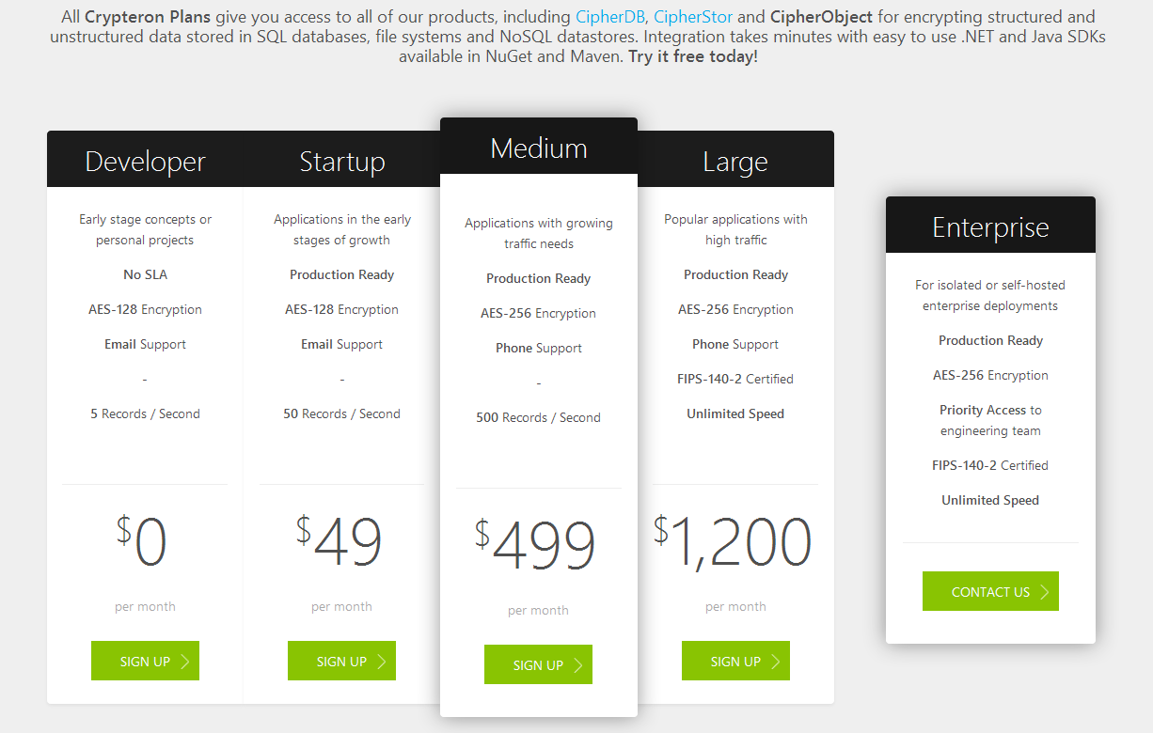
Pricing and Plans

Slide 23
Demo time!
Upgrading a generic ASP.NET app for security in seconds …

Slide 24
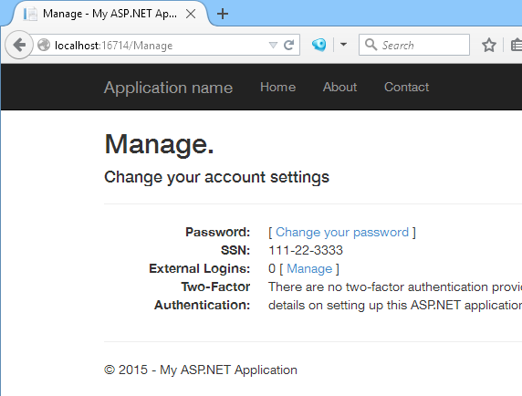
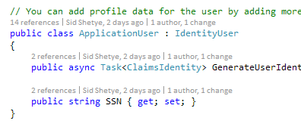
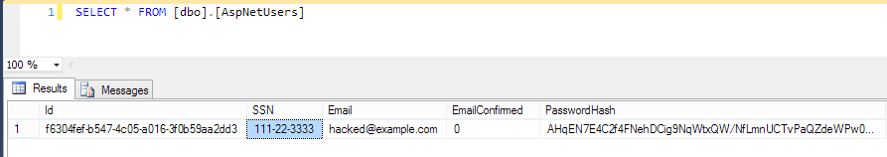
Rest of code …
By itself
C# Code
Database

Slide 25
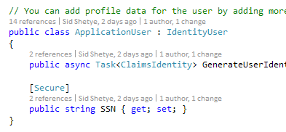
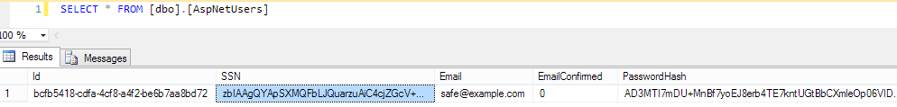
Rest of code unchanged!
Powered by
Crypteron
C# Code
Database

Slide 26


Since you made it this far …
2 months free off any paid plan
  All signups start on free plan
  If/when you upgrade, you’ll get 2 months free
  But only if your original signup is via this link!
  https://www.crypteron.com/promo/azureug/

Slide 27
Community efforts
OpenSource Healthcare

Slide 28

CloudMedic – Open sourced HIPAA
Crypteron will be releasing CloudMedic – a bootstrap healthcare backend app – end of August
Aims at improving state of healthcare security
Aims at accelerating innovation in healthcare
http://CloudMedic.io
Video demo: https://www.youtube.com/watch?v=Q3RpAY0VQs0

Slide 29

Thank you
Sid Shetye (CEO & Founder)
sid@crypteron.com
Support
support@crypteron.com
2 Months free off any paid plan!
https://www.crypteron.com/promo/azureug/

